Slide 1


Using Python in ArcGIS Platform
Tospol Toommala

Slide 2

Using Python in ArcGIS Platform
ArcGIS API for Python + Portal for ArcGIS
ArcPy + ArcGIS Pro

Slide 3
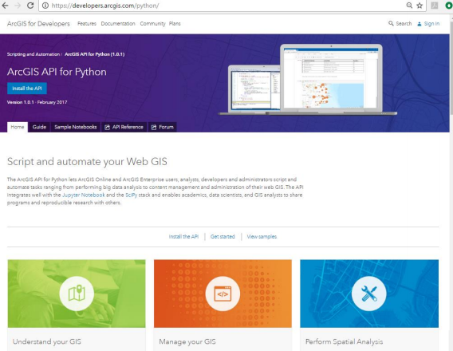
ArcGIS API for Python
Python 3.5
Anaconda
Jupyter Notebook

Slide 4
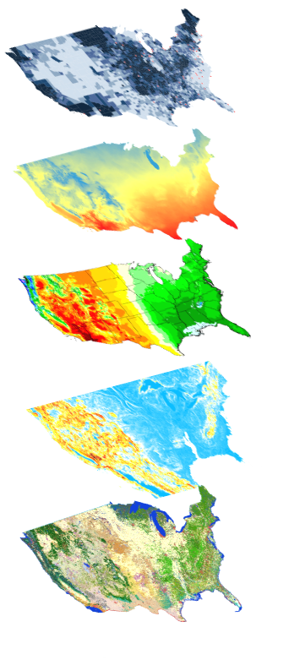
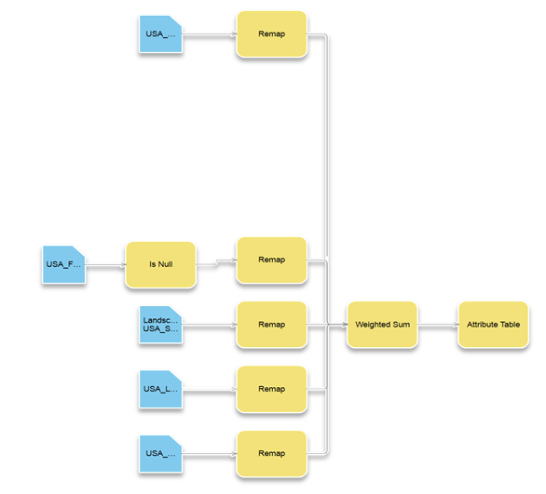
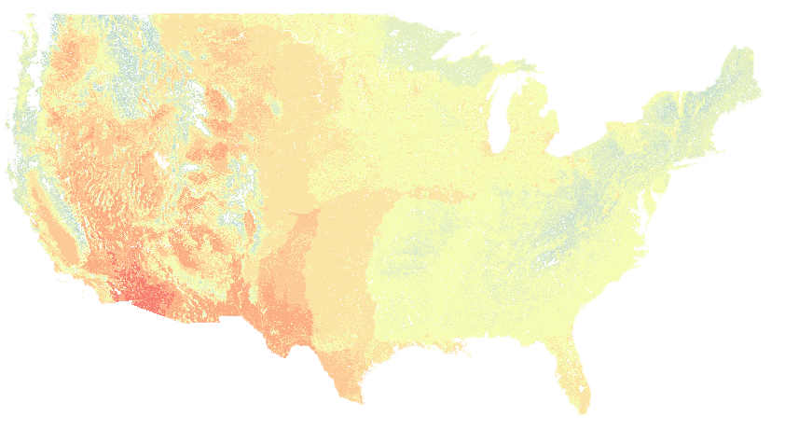


ArcGIS API for Python
Big Data
Spatial Analysis
Raster Analytics
Imagery
Location Analytics
Feature Analytics
Platform API
Power Users
Developers
Analysts
Data Scientists
Enterprise Integration
Users, Roles & Group management
Administrators
DevOps
Content Publishers
Data Management

Slide 5
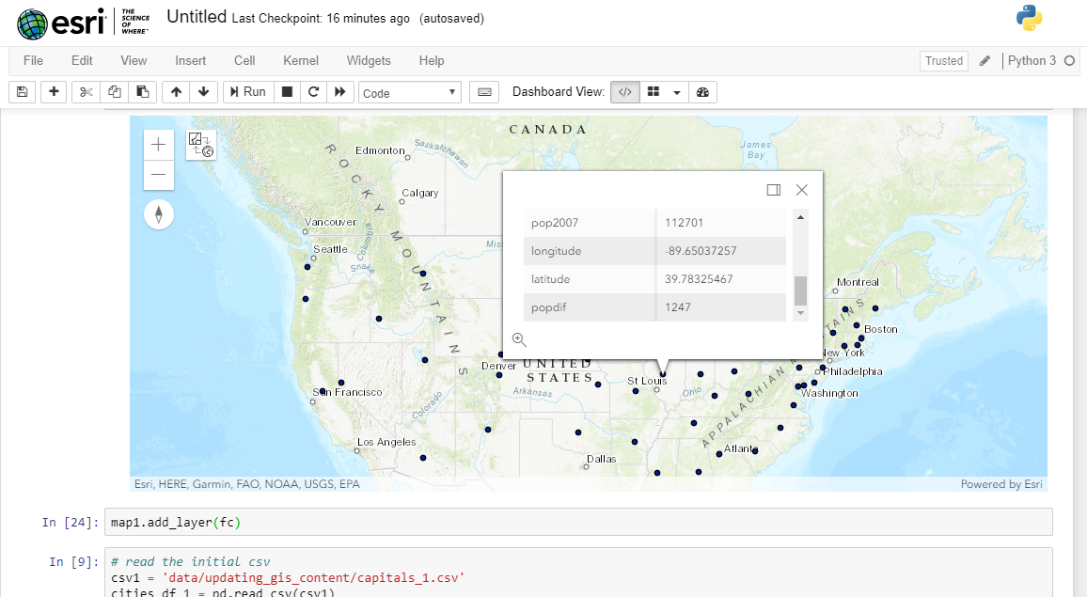
Demo
Connect to Portal
Read csv
Manipulate data
Show in map

Slide 6
Demo
#Access the portal using "amazing_arcgis_123" as password for the given Username.
gis = GIS("https://python.playground.esri.com/portal", "arcgis_python")
old_one = gis.content.search('capitals_1.csv')
old_one
gis.content.delete_items(old_one)
old_2 = gis.content.search('USA Capitals 2')
old_2
gis.content.delete_items(old_2)
updated_df['popdif'] = updated_df['pop2007'] - updated_df['pop2000']
updated_df
fc = gis.content.import_data(updated_df)

Slide 7
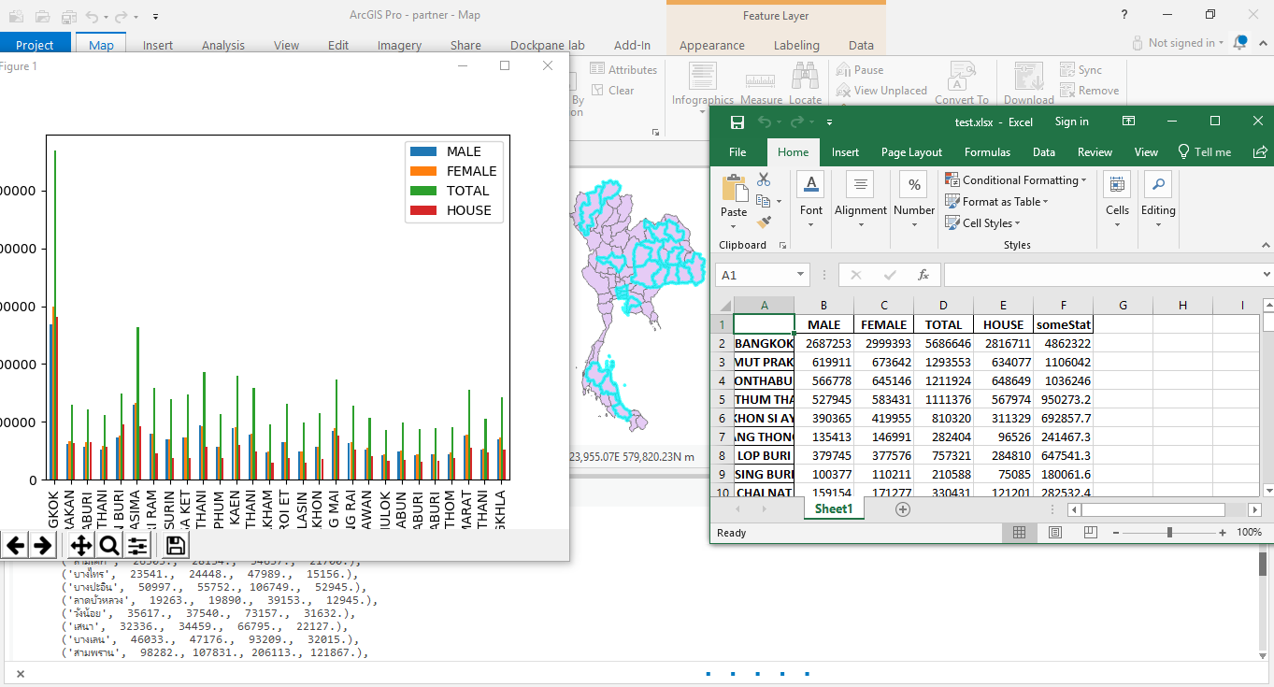
ArcPy
Python interactive in ArcGIS Pro
Interact with ArcGIS Pro
Use in Python script model

Slide 8
Demo
Python interactive in ArcGIS Pro
Convert data for analyze
Add and calculate
Export to excel

Slide 9
Demo
import arcpy
Import pandas as pd
arcpy.SelectLayerByAttribute_management('PROVINCE',where_clause='TOTAL>1000000')
province = arcpy.da.FeatureClassToNumPyArray('PROVINCE',['PROV_NAME','MALE','FEMALE','TOTAL','HOUSE’])
df = pd.DataFrame(province,index=province['PROV_NAME'],columns=['MALE','FEMALE','TOTAL','HOUSE’])
dfMean = df[df['TOTAL']>df['TOTAL'].mean()] import matplotlib.pyplot as plt
dfMean.plot(kind='bar’)
plt.show()
df['someStat'] = (df['TOTAL'].std()/df['TOTAL'].mean())*df['TOTAL’]
df.to_excel('test.xlsx')

Slide 10


Slide 11



